Slide 1
Under the Hood:
Twitch Trust & Safety
Notes:
Here is a speaker note

Slide 2
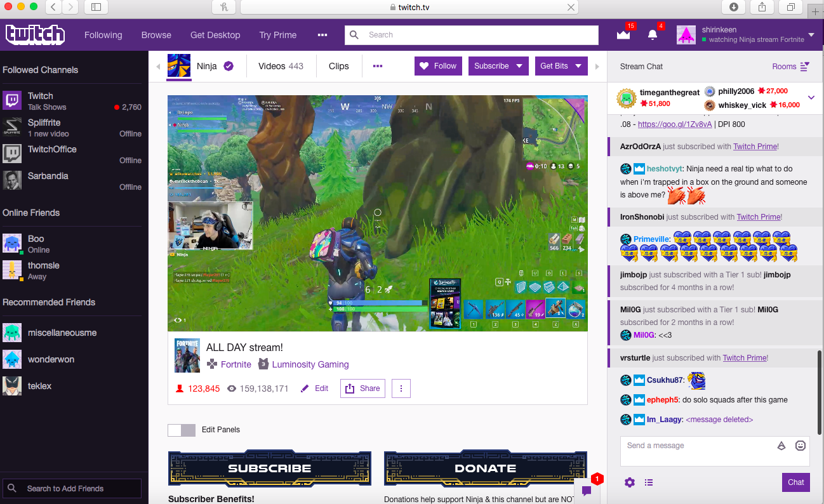
Notes:
For uninitiated, Twitch is a social video service for broadcasters and their audiences to interact in real time over shared interests, primarily gaming content, over 90% live. Ninja, one of our most popular broadcasters, recently broke a record with 630K concurrent viewers on a channel; here a not too shabby 124K people are watching and chatting live. 2 million unique monthly broadcasters on Twitch, and over 15 million active users a day, watching 355 billion minutes of content in 2017.

Slide 3
Moderation Contributes to Creator Success
Engagement
Creator & community interaction
Success
Viewers, chatters, subscribers, cheers
Moderation ➔ Trust & Safety
Appropriate content, effective rules, consistent enforcement, and inclusive community.
Notes:
Twitch’s value – creators first, vision is to enable 100 million creators to earn a living on Twitch.

Slide 4
Toxicity is Bad Business
“Roughly four-in-ten Americans have personally experienced online harassment, and 62% consider it a major problem.“
Pew Research Center
“A user who experiences toxicity is 320% more likely to quit.”
Jeffrey Lin, Riot Games

Slide 5
Goals of Twitch Trust & Safety
Maintain effective policies & tools
Community Guidelines
User reporting and processing tools
AutoMod, Spam filters, AudibleMagic
Enforce policies consistently
Moderate 24 / 7 / 365
5 min SLA for Reported Content
Notes:
Live nature of service makes quick action critical

Slide 6
Trust & Safety Structure
Trust & Safety Ops
Trust & Safety Products
Policy (1)
Enforcement (33)
Product Managers (2-3)
Engineering (6-8)
Legal, Data Science, TPM, PMM
Notes:
Who makes this happen

Slide 7
Policy Development
New Product and Content Launches
Feedback from enforcement
Legal or other external developments
Constant iteration of internal enforcement guides
Content, Partnerships, Customer Support, Community
External experts (informal)
Notes:
Evolution of gaming to creative other content

Slide 8
Enforcement
Identify
2. Stop
3. Communicate
4. Rehabilitate
Identify violations of Twitch policies via user reports and copyright infringement notices.
Stop abuse by issuing account suspensions and removing content, and discourage further abuse by account strikes.
Communicate penalties issued and current account status via notifications to the affected user(s).
Rehabilitate affected user(s) through education and processing suspension appeals when appropriate.

Slide 9
ALL reported incidents are reviewed by
human moderators.

Slide 10
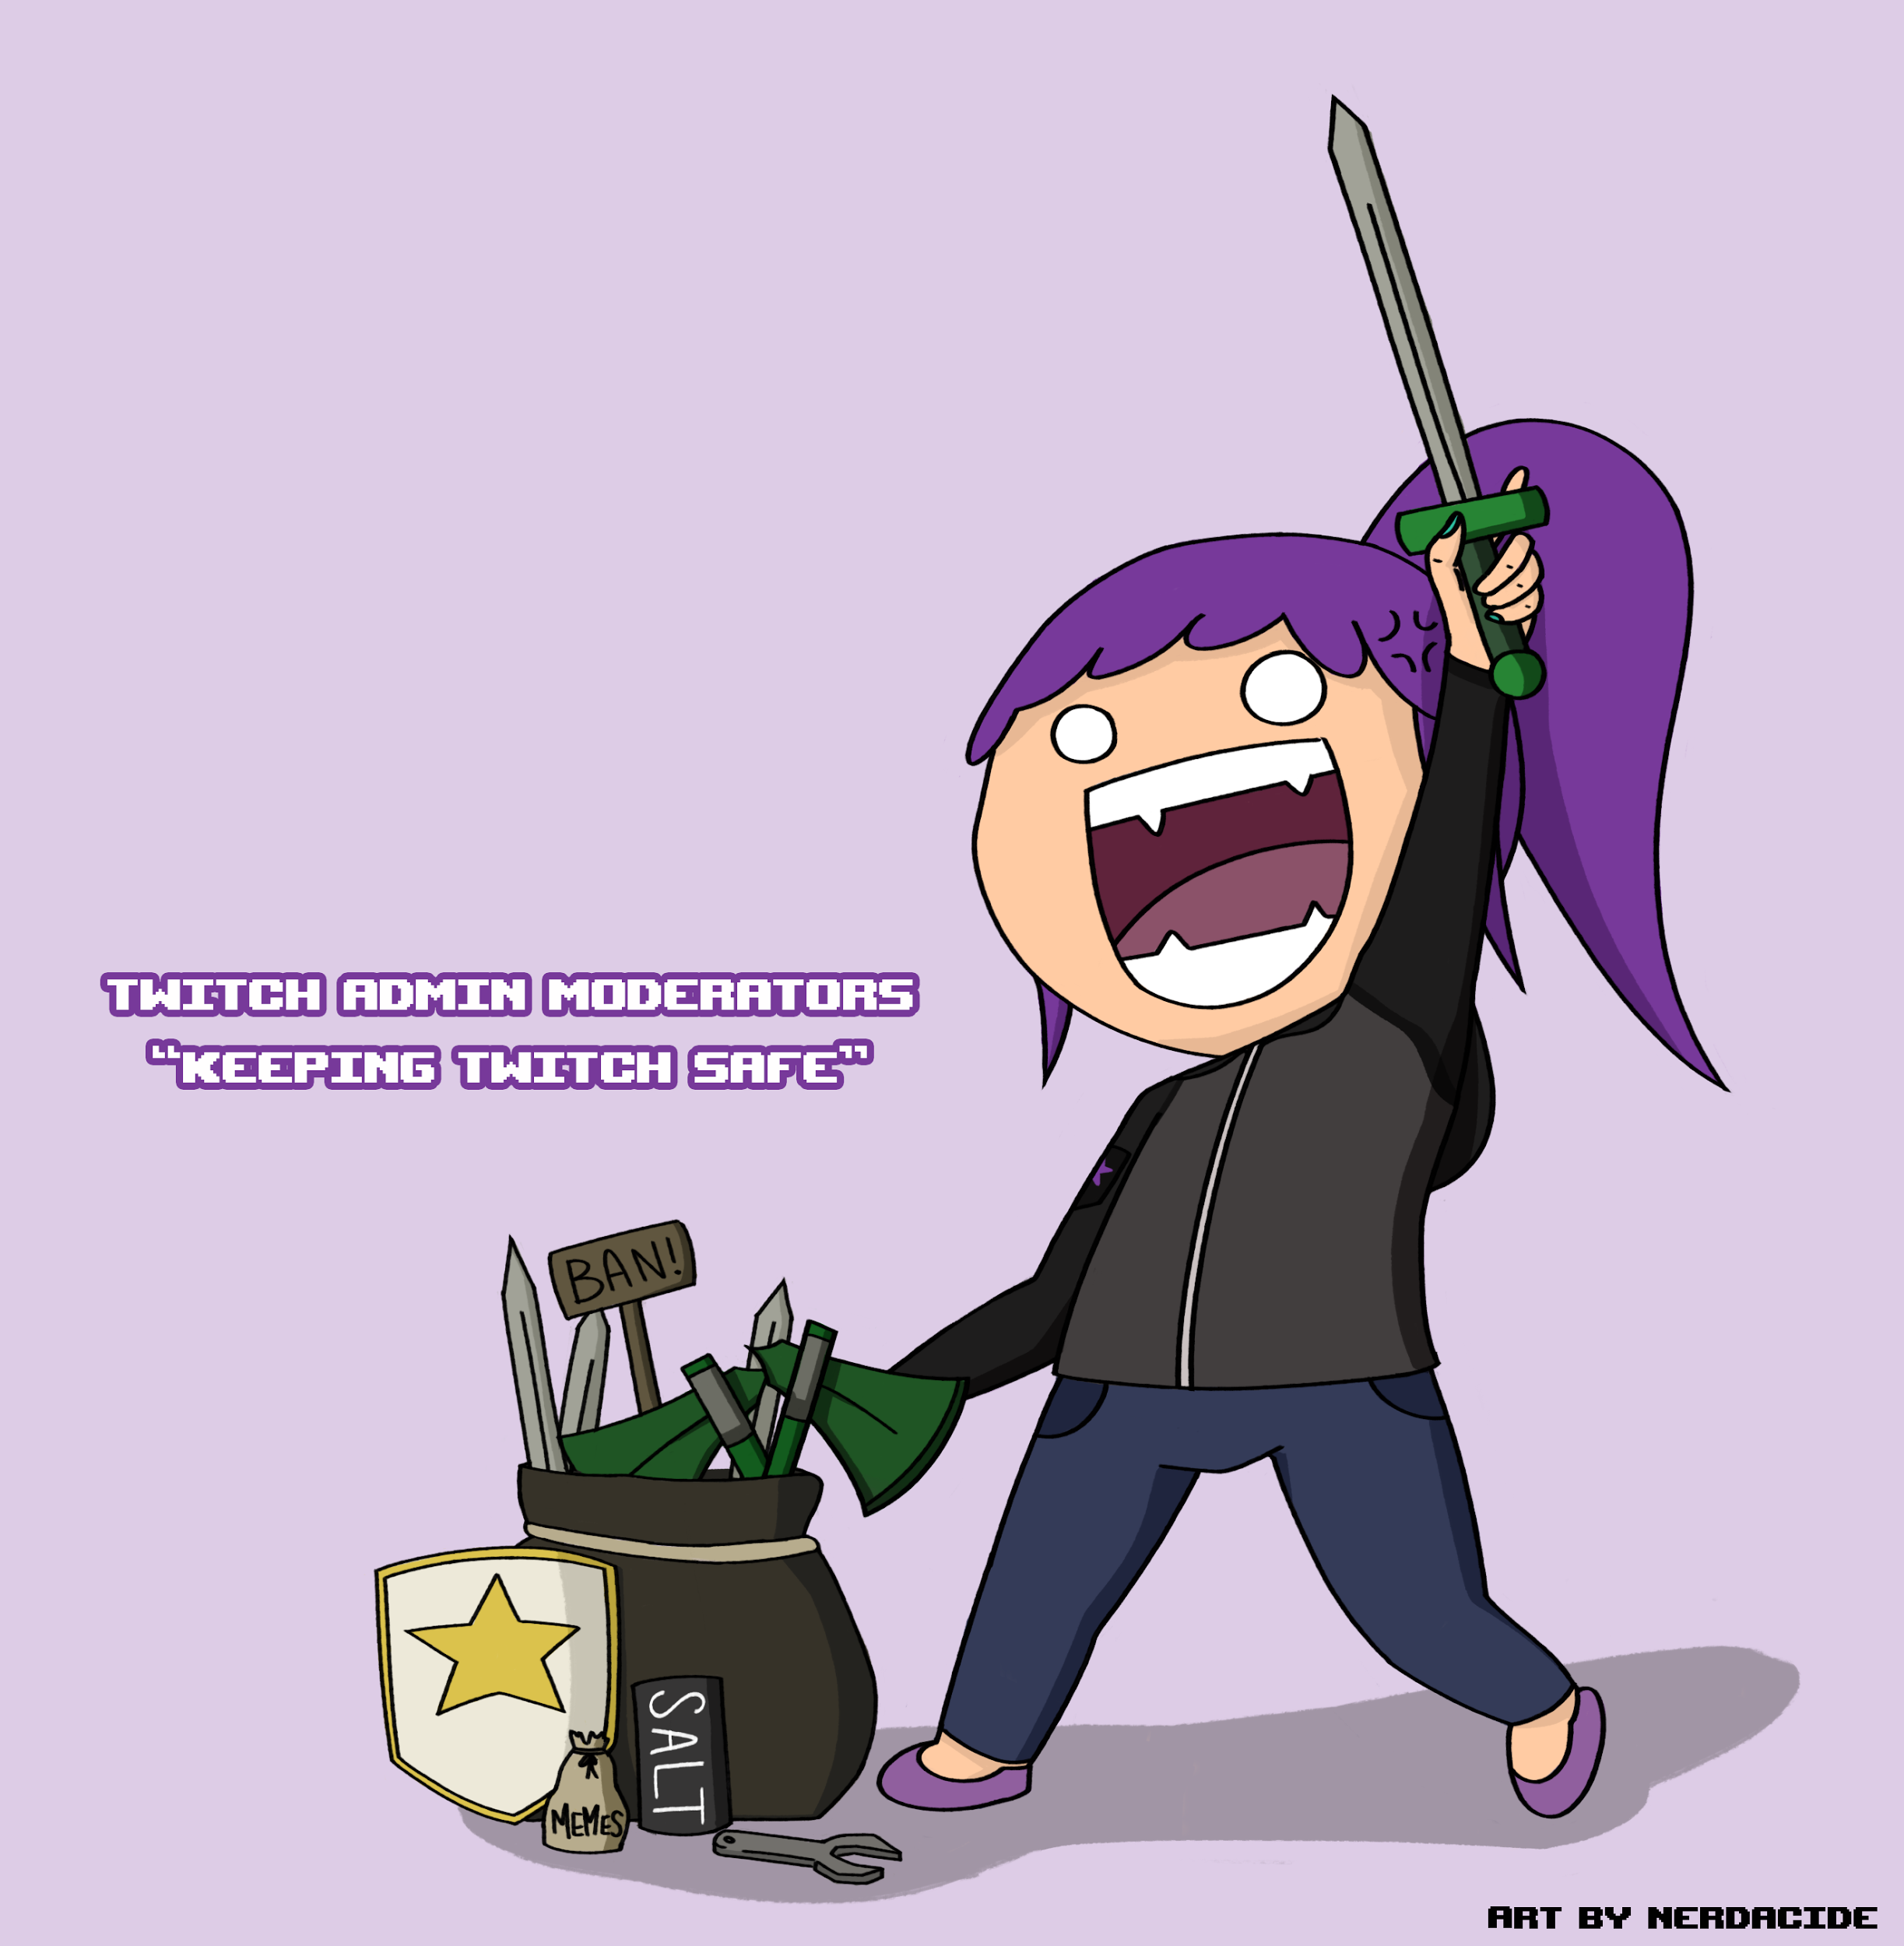
Twitch Moderators
Always on duty, 24 hours a day
Experts, in tune with Twitch services & the community
Diverse in language, cultural background, & experience

Slide 11
3.0 M
Total user reports received in 2017
User Reports
More ways to report, easier ways to report

Slide 12
Twitch Moderation vs Channel Moderation
Community based
Twitch Channel
Channel Moderation
Broadcaster
Broadcaster-appointed Moderators
Policies
Chat rules, modes, & settings
Enforcement
AutoMod & bans/timeouts
Twitch Service
Twitch Moderation
Moderation Staff
Policies
Terms of Service
Community Guidelines
Enforcement
Account strikes & suspensions

Slide 13
>99 %
Of top 500 Twitch channels have moderator(s)
Appointed Mods
Trustworthy mods that moderate with broadcaster’s goals in mind
Set an example for chat to follow

Slide 14
75 %
Decrease in spam in 2017
Automated Tools
User abuse detection
Spam identification
Heuristic Checks
Machine Learning

Slide 15
Messages caught by AutoMod are
10 x
more likely lead to a timeout or ban than non-caught message
AutoMod
AutoMod catches missspellinsg, ev@s1on, and 1 3 3 7 S P E E K
Mods can approve and deny caught messages before others see them
It learns for each channel, based on mod actions

Slide 16
40 M
Total timeouts and bans by 3rd party bots in 2017
Third Party Tools
Make it easy to develop tools for Twitch
Currently 3000+ 3rd party bots in use
Help with moderation and engagement

Slide 17
What’s Next?
2018 and Beyond
Transparency, Fairness, Efficiency
Broader coverage, more precise action, better communication
Internal and external toolsets; better data
Operational improvements
Notes:
Operational: policy development, incident response. Tools: Reporting wizard, aegis, cena, age gate (viewer side; automod). Fairness: granular punishments / partner moderation alignment, clearer feedback loop, data.

