Slide 1
GitHub@COMO
@talniv

Slide 2
Legal Product / Governance
Developer Community Support
Product
Legal Support
TOS Support
Policy
Community and Safety
Content Policy & Governance
Support

Slide 3
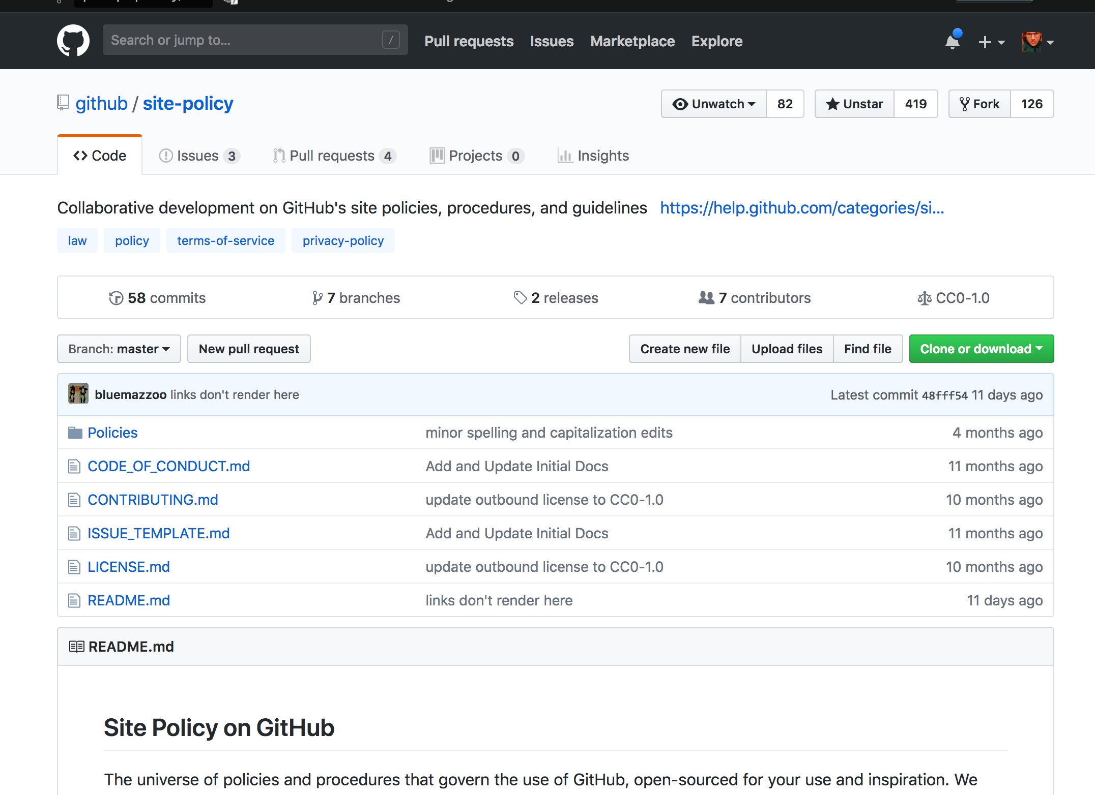

Slide 4
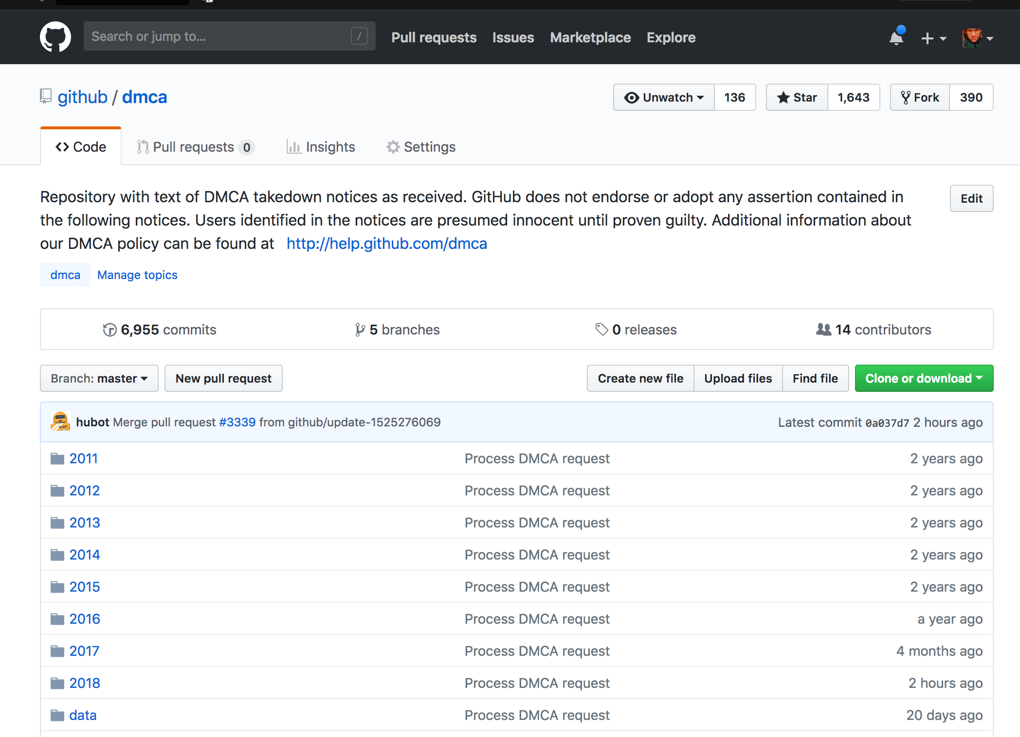

Slide 5
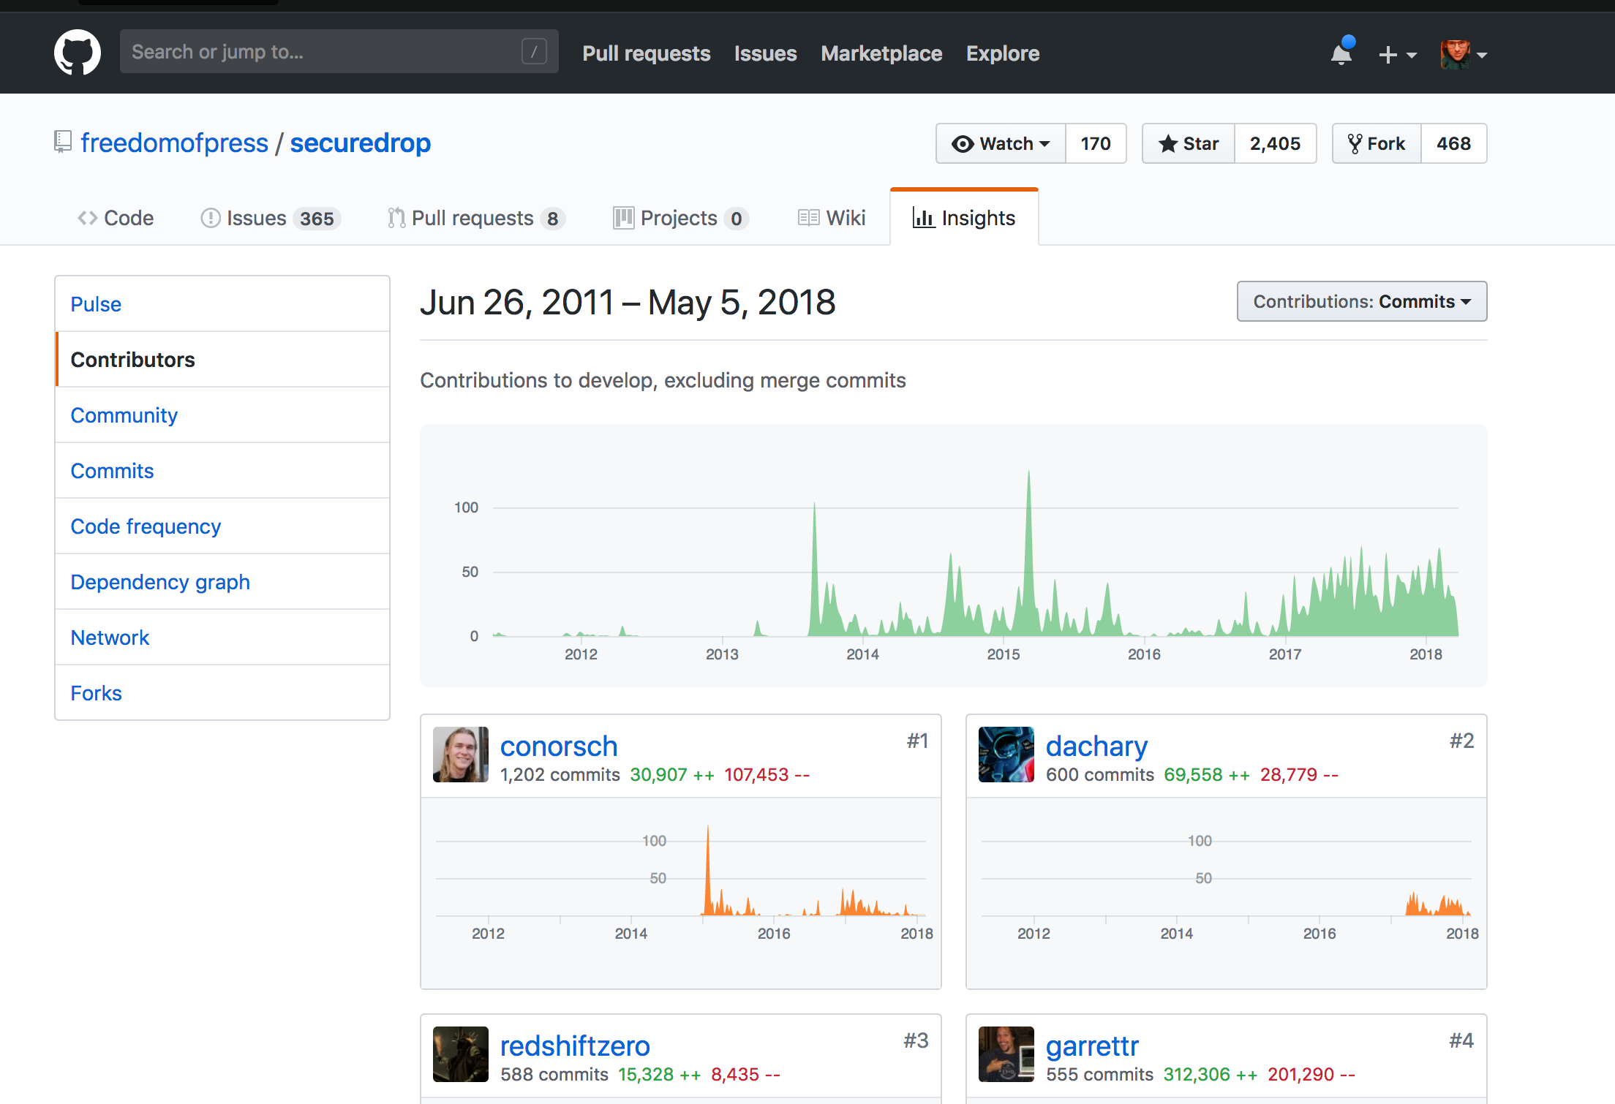

Slide 6
