Slide 1
Moderating Frame By Frame
Trust & Safety and Content Moderation at
Notes:
Title Slide with Subtitle and Logo

Slide 2
Vimeo at a Glance
You know… for videos.
Vimeo empowers video creators of all kinds to tell exceptional stories and connect with their audiences and communities.
Home to more than 70 million members in over 150 countries, Vimeo is the world’s largest ad-free open video platform and provides powerful tools to host, share and sell videos in the highest quality possible.
Notes:
One Column Text

Slide 3
Trust & Safety at Vimeo
Mission Statement: What Are Our Core Goals?
To make Vimeo’s Creators feel comfortable sharing their work and data with us.
To make Vimeo’s Audience feel safe spending their time and money with us.
To make Vimeo’s Partners feel proud associating their brand with us.
To make Vimeo itself fully compliant with applicable laws, available and unblocked in as many jurisdictions as possible, and insulated from liability.
Notes:
One Column Text

Slide 4
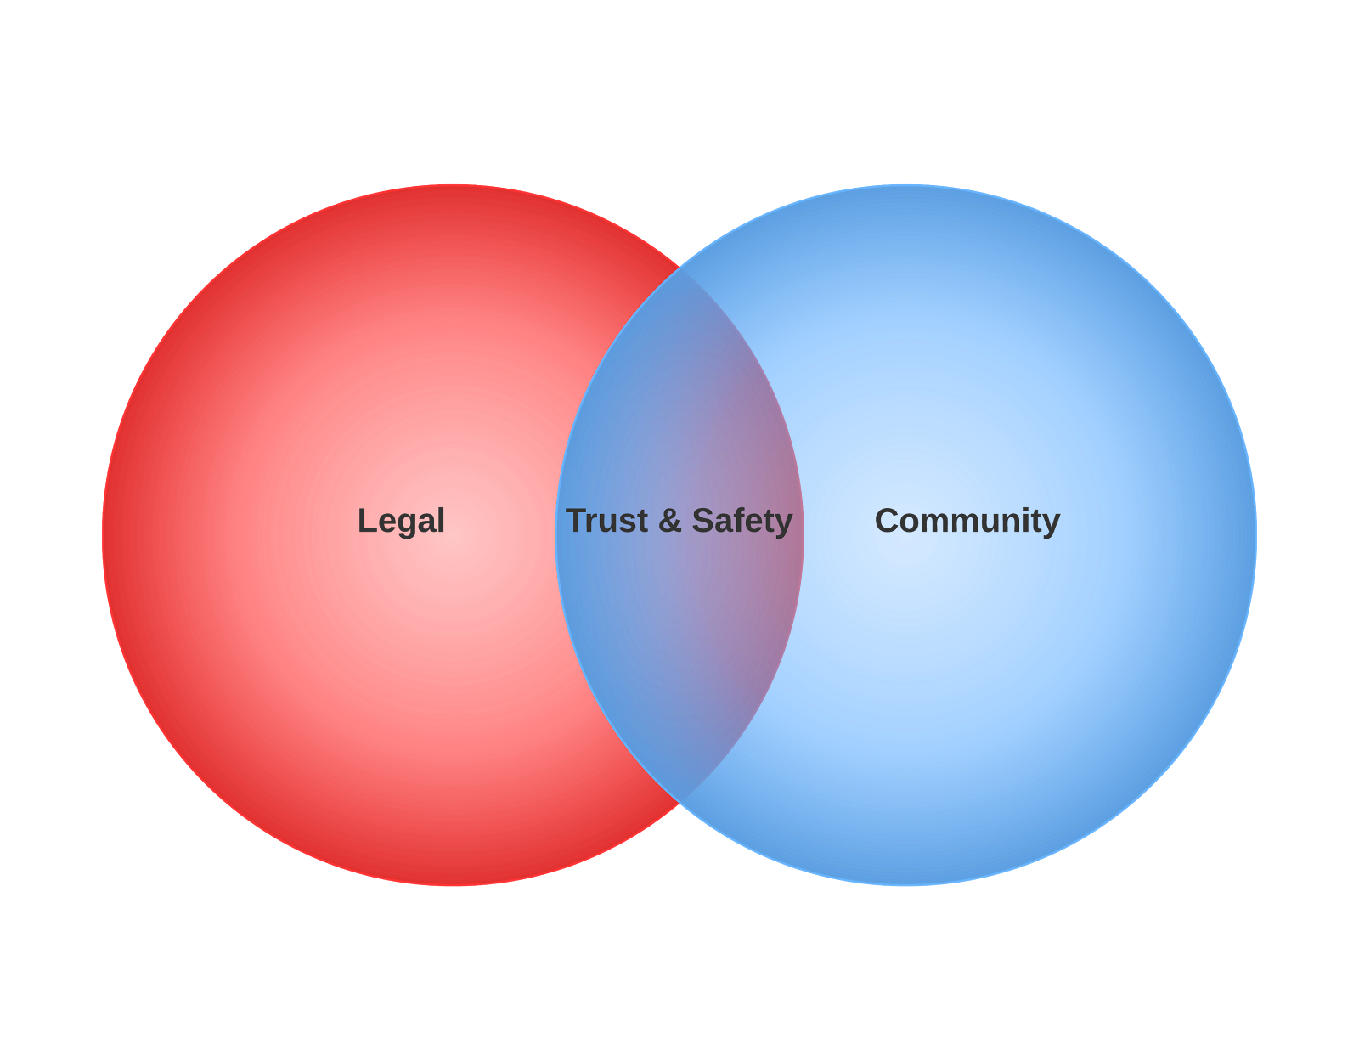
Trust & Safety at Vimeo
Team Structure: Who Are We?
5 Trust & Safety Specialists + 1 Dedicated Developer
Team composition is split between legal, operations, and community support backgrounds
Part of the Legal Department, overlap with the Community Support team
Notes:
wduwdh

Slide 5
Trust & Safety at Vimeo
Remit: What’s Our Daily Grind?
Broadly:
To enforce Vimeo’s Terms of Service and Community Guidelines
Specifically:
Copyright & Trademark Infringement
Privacy Complaints
Defamation Complaints
Sextortion
Pornography
Hate Speech
Extremist Propaganda
Spam
Abuse
Harassment
Commercial Content Policy Violations
Fraud
Violence
Gore
Phishing & Account Takeover (ATO)
LEO & Government Reporting and Requests
Notes:
One Column Text

Slide 6
Trust & Safety at Vimeo
Content Moderation Pipeline
Intake:
User flagging
Takedown notice/cease and desist
Algorithmic detection
Proactive investigation
Decision:
Specialists have broad discretion
Policy edge cases and outliers:
Trust & Safety Team Consensus => Legal Review => Brand & Culture Stakeholders
“Purg” either specific video or entire account
Aftercare:
Investigation of related accounts
User appeals and remediation
Notes:
wduwdh

Slide 7
Trust & Safety at Vimeo
Vimeo’s Content Moderation Challenges
We know it when we see it. Mostly.
Scale. 5 Against the World.
Global platform. Hard to know linguistic, socio-political, cultural, legal, and interpersonal dynamics for some videos.
Spammers and other bad actors are super adaptive.
No ads = No monetization.
Professional user base can require additional handholding.
Vimeo’s Content Moderation Advantages
Community culture is positivity focused.
No ads = No monetization.
One type of content.
Motivated flaggers. User base is dedicated to keeping the ”streets” clean.

Slide 8
Thank You
Notes:
Thank You Slide

